Slide 1
Spam Detection Using Text Classification
Team Members:
Sai Tejini Varma Sangaraju(z1948240)
Mounika Chalichalamala(z1974893)
Manoj Kumar Edupulapati(z1947031)

Slide 2
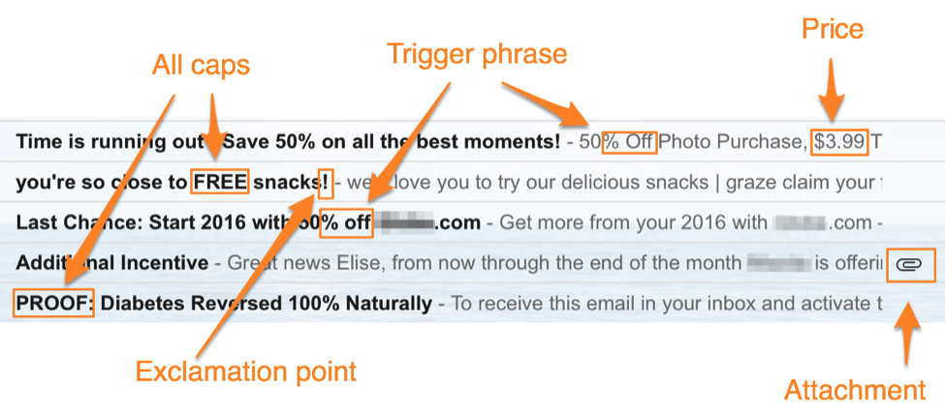
Spam Content and detection
Spam Content refers to inappropriate messages that are sent across various platforms like SMS, email, social media in a convincing way, making it difficult to identify them as being sent maliciously or for product promotion.
Since these spam messages attempt to obtain our personal information without our awareness, detecting them has become crucial.

Slide 3
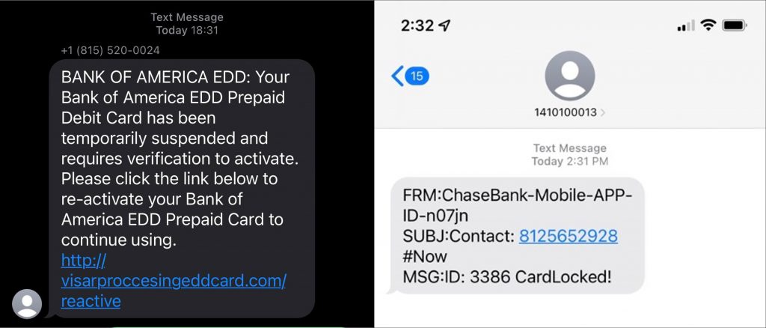
Short Message Service(SMS)
SMSs are widely used for personal and business use as it one of the fastest and easiest ways of communication.
But a lot a spam messages are sent and predicting these messages is still one of the main concerns.

Slide 4
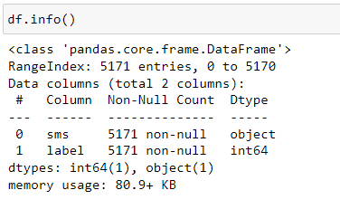
Dataset
A Dataset from Kaggle website is considered to perform the analysis. The attributes of the dataset are:
Sms: Contains the text message.
Label: It indicates whether the message is spam or non-spam.
0 – The message is non-spam
1 – The message is spam.
https://www.kaggle.com/datasets/thedevastator/sms-spam-collection-a-more-diverse-dataset

Slide 5
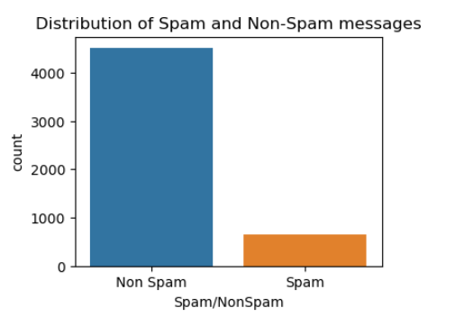
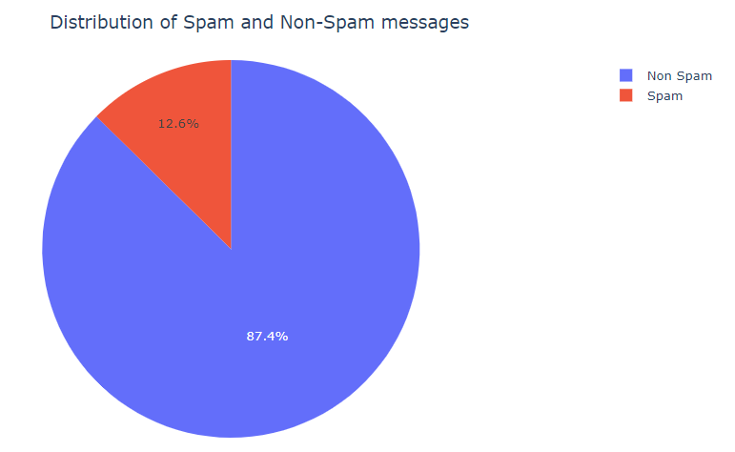
Count plots on the Target variable

Slide 6
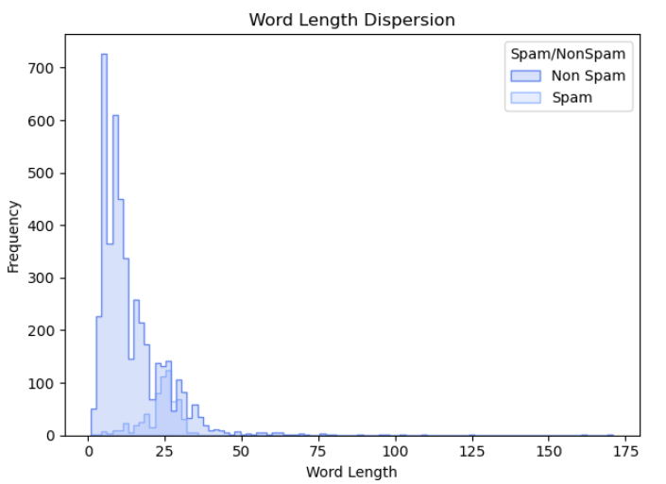
Word Length Dispersion
Spam messages are most likely to be lengthy messages.

Slide 7
Data Preprocessing
Data cleaning: Used CleanTransformer for cleaning the data.
Replace all URLs with a special token
Replace all email addresses with a special token
Replace all phone numbers with a special token
Replace all numbers with a special token
Replace all currency symbols with a special token
Remove punctuations

Slide 8
Stop Words Removal:
Stop words are the most commonly used words which can be ignored while performing analysis. These include words like a, the, in and so on.
Stemming:
This process is performed to transform various inflected words into their root forms which reduces the dimensionality which means that the vocabulary size is reduced.
Worked – work
Works – work
Working - work

Slide 9
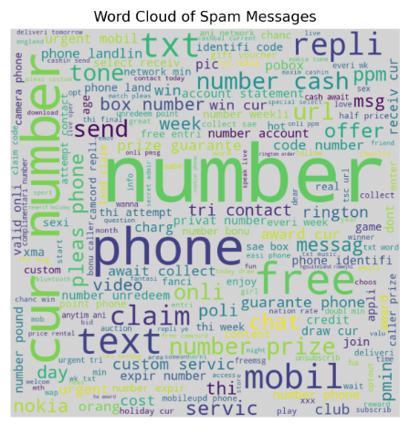
words in the cleaned sms:

Slide 10
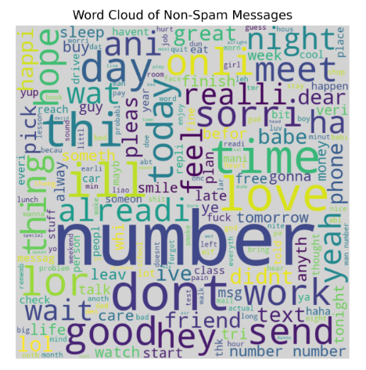

Slide 11
Machine Learning Algorithm – Naive Bayes Classifier
Based on the naive bayes formula this model determines the probabilities of each word in a message to determine whether the message is spam or non spam.
The spam probabilities of all words in the message are multiplied together to determine whether a message is spam or not.
The Multinomial Naive Bayes model classifies the message as spam or non spam message if P(Spam | word) > 0.5

Slide 12
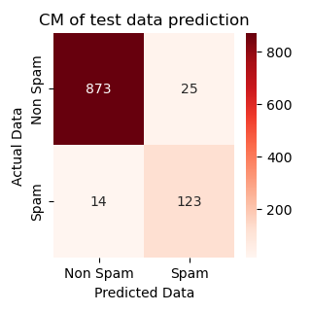
To build this model we first performed TF-IDF to find out the importance of each word in the given dataset.
Split the data into training and testing set.
Trained the model based on naïve bayes classifier and achieved accuracy of 96%.

Slide 13
Deep Learning Models
Deep learning models are built with the ability to understand sentence semantics to make predictions on the given data.
Knowing the semantics of the sentence will help the model to make more accurate predictions as the meaning of the text is considered.
We have examined Long Short-Term Memory (LSTM), one of the numerous deep learning models that are currently accessible.

Slide 14
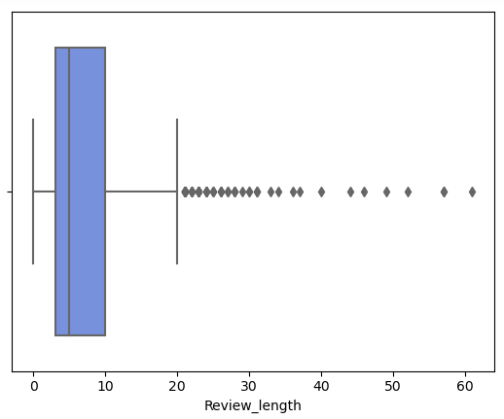
Box Plot

Slide 15
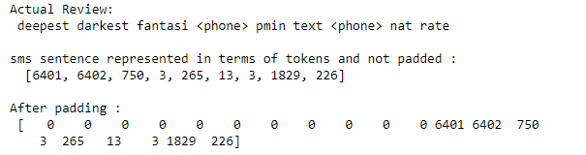
Pre-Padding

Slide 16
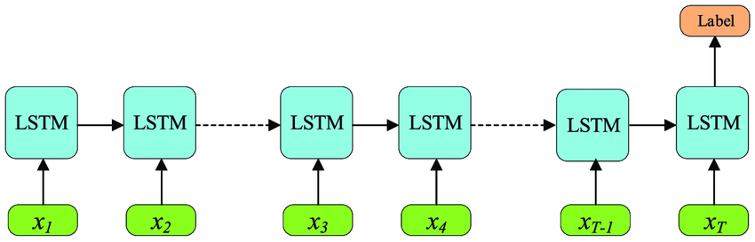
Long Short-Term Memory (LSTM)

Slide 17
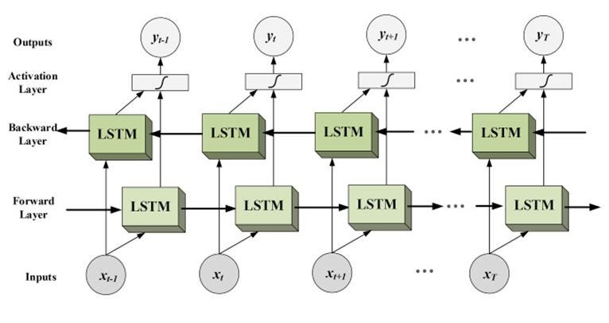
Bi-Directional LSTM

Slide 18
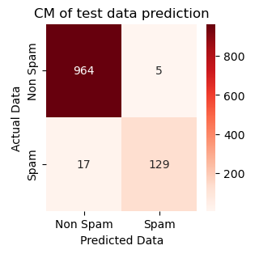
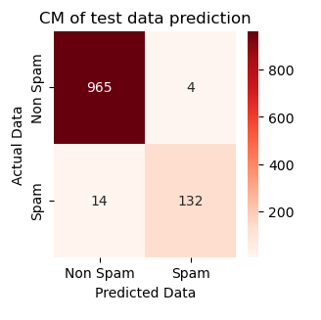
Comparison Of Results
LSTM Bi-directional LSTM
Accuracy is 98.03% Accuracy is 98.39%

Slide 19
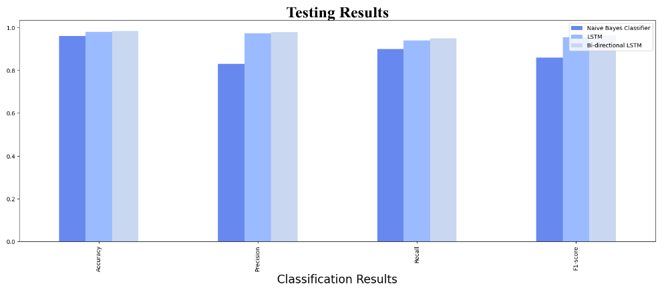

Slide 20
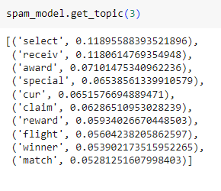
bertopic
BERTopic is an open-source library which uses bert model to do topic detection.
Bert is a pretrained model on large corpus of data which makes it easier to understand the semantics of the sentence.
It predicts the meaning of the word based on its context.

Slide 21
References
https://www.kaggle.com/datasets/thedevastator/sms-spam-collection-a-more-diverse-dataset
https://www.kaggle.com/code/muzzzdy/sms-spam-detection-with-various-classifiers
https://ieeexplore.ieee.org/document/9421225
https://medium.com/@insight_imi/sms-spam-classification-using-na%C3%AFve-bayes-classifier-780368549279#:~:text=By%20using%20the%20alternative%20form,message%20is%20spam%20or%20not.
https://www.geeksforgeeks.org/bidirectional-lstm-in-nlp/
https://hackernoon.com/nlp-tutorial-topic-modeling-in-python-with-bertopic-372w35l9

Slide 22
Thank
You

